Slide 1
Computer Architecture
BHAVANA
DAY 1
01/04/2024

Slide 2
What is a Computer
Introduction
A computer is an electronic device that can perform various tasks by executing instructions. It consists of several components that work together to process and store data.
Basic Functionalities
Computers can perform tasks such as processing data, storing information, and executing programs. They can also connect to networks and interact with users through input and output devices.

Slide 3
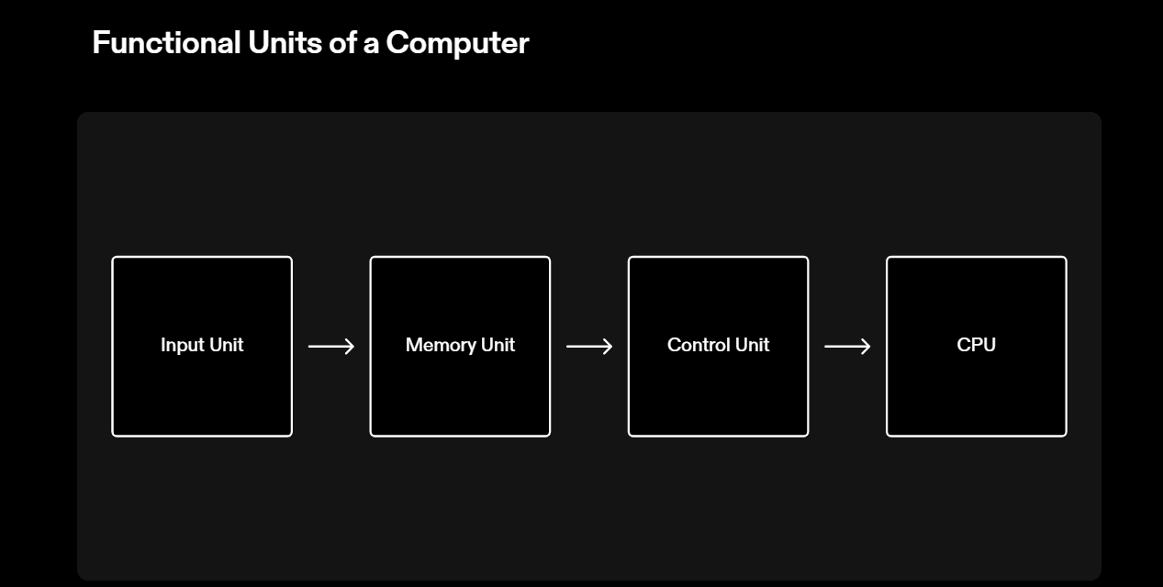

Slide 4
Instructions and Data:
Instructions
Instructions are the commands that tell the computer what to do.
They are represented in binary form as a sequence of 0s and 1s.
Instructions are stored in the computer's memory and fetched by the processor.
Data
Data is the information that the computer processes.
It can be numbers, text, images, or any other type of information.
Data is also stored in the computer's memory and can be manipulated by the processor.

Slide 5
Input Unit
The input unit is responsible for receiving data and instructions from external sources and transferring them to the computer's memory. It acts as a bridge between the external world and the computer system.
Functions of the Input Unit
Data Reception: The input unit receives data from various input devices such as keyboards, mice, scanners, and microphones.
Data Conversion: It converts the received data into a form that can be understood and processed by the computer.
Data Validation: The input unit checks the validity and accuracy of the received data to ensure that it is error-free.
Data Buffering: It temporarily stores the received data in a buffer before transferring it to the computer's memory.

Slide 6
Memory Unit:
The memory unit in a computer system is responsible for storing and retrieving data. It consists of two main types of memory: primary memory and secondary memory.
Primary Memory
Primary memory, also known as main memory, is the immediate storage location that the CPU can access directly. It is volatile, meaning that its contents are lost when the computer is powered off. The two main types of primary memory are:
Random Access Memory (RAM): RAM is used to store data that is actively being used by the CPU. It provides fast access to data but has limited capacity.
Read-Only Memory (ROM): ROM is used to store permanent data that is essential for booting up the computer. It retains its contents even when the computer is powered off.
Secondary Memory
Secondary memory, also known as auxiliary memory, is used for long-term storage of data. It is non-volatile, meaning that its contents are retained even when the computer is powered off. Common types of secondary memory include hard disk drives (HDDs), solid-state drives (SSDs), and optical discs.

Slide 7
Control Unit:
The control unit is a crucial component of a computer system that manages and coordinates the activities of the other hardware components. It is responsible for executing instructions and controlling the flow of data within the system.
Functions of the Control Unit
Instruction Fetch: The control unit retrieves instructions from memory and prepares them for execution.
Instruction Decoding: It interprets the fetched instructions and determines the necessary actions to be taken.
Instruction Execution: The control unit coordinates the execution of instructions by sending control signals to the appropriate components.
Data Movement: It controls the movement of data between the memory, registers, and other components.
Control Transfer: The control unit determines the next instruction to be executed based on the program counter and the instruction being executed.

Slide 8
RAM
Random Access Memory (RAM)
RAM, or Random Access Memory, is a crucial component of a computer system. It is a type of volatile memory that allows the computer to store and access data quickly. RAM is used to temporarily store data that the computer needs to access frequently, such as the operating system, applications, and data currently being used by the user.
How RAM Works
When the computer is turned on, the operating system and other necessary files are loaded into RAM. This allows the computer to access these files quickly, speeding up the overall performance. RAM works by storing data in cells that can be accessed randomly, hence the name. Each cell has a unique address, allowing the computer to read and write data to specific locations in the RAM.
Importance of RAM
RAM plays a vital role in determining the speed and efficiency of a computer system. The more RAM a computer has, the more data it can store and access quickly. This is particularly important for tasks that require a large amount of data to be processed simultaneously, such as video editing, gaming, and running multiple applications at once.

Slide 9
Types of RAM
There are several types of RAM, including:
Dynamic RAM (DRAM): The most common type of RAM used in computers. It stores each bit of data in a separate capacitor within an integrated circuit.
Static RAM (SRAM): Faster and more expensive than DRAM. It uses flip-flop circuits to store each bit of data.
Synchronous Dynamic RAM (SDRAM): A type of DRAM that synchronizes with the computer's bus speed, allowing for faster data transfer.
Double Data Rate Synchronous Dynamic RAM (DDR SDRAM): An improved version of SDRAM that transfers data on both the rising and falling edges of the clock signal, effectively doubling the data transfer rate.
Conclusion
RAM is an essential component of a computer system, providing fast and temporary storage for data that the computer needs to access frequently. The amount and type of RAM in a computer can significantly impact its performance, especially when it comes to multitasking and resource-intensive tasks.

Slide 10
CPU (Central Processing Unit):
What is a CPU?
The CPU is the primary component of a computer system responsible for executing instructions and performing calculations.
Core Functions
The CPU performs three core functions: fetch, decode, and execute instructions.
Fetch
The CPU retrieves instructions from the computer's memory.
Decode
The CPU decodes the instructions into a format that it can understand and execute.
Execute
The CPU carries out the instructions by performing calculations and manipulating data.

Slide 11
RISC (Reduced Instruction Set Computing)
Simple and streamlined instruction set
Emphasizes executing a large number of simple instructions
Instructions are executed in one clock cycle
Requires more instructions to perform complex operations
Used in mobile devices, embedded systems, and high-performance computing
CISC (Complex Instruction Set Computing)
Rich and diverse instruction set
Emphasizes executing complex instructions that can perform multiple tasks
Instructions may require multiple clock cycles to execute
Performs complex operations with fewer instructions
Used in desktop computers, servers, and mainframes

Slide 12
Bus Structure
The bus structure is a crucial component of computer architecture that facilitates communication between different components. It consists of several buses that transfer data, addresses, and control signals between the CPU, memory, and other peripheral devices.
Components of the Bus Structure
Address Bus: This bus carries the memory addresses that specify the location of data to be accessed or stored.
Data Bus: The data bus transfers the actual data between the CPU and memory or other devices.
Control Bus: The control bus carries control signals that coordinate and synchronize the activities of different components.
Communication in the Bus Structure
When a component needs to read or write data, it sends the appropriate address and control signals through the address and control buses. The data is then transferred through the data bus. This allows for efficient and simultaneous communication between multiple components.
Benefits of the Bus Structure
Simplifies the design and construction of computer systems.
Facilitates the sharing of resources between different components.
Enables the efficient transfer of data and instructions between components.
Provides a flexible and scalable architecture for future expansions and upgrades.

Slide 13
Drawbacks of the Single Bus Structure
Limited Bandwidth
The single bus structure has a limited capacity to transfer data between components, resulting in lower overall system performance.
Potential for Bottlenecks
The single bus structure can create bottlenecks when multiple components try to access the bus simultaneously, leading to delays and decreased efficiency.
Reduced Scalability
The single bus structure is not easily scalable as the number of components and data traffic increases, making it less suitable for complex and high-performance systems.

Slide 14
Software
Operating System
The operating system plays a crucial role in managing and accessing memory in a computer system. It provides the necessary software infrastructure to allocate and deallocate memory resources among different processes. It also ensures that each process has access to the memory it requires while preventing unauthorized access.
Memory Management
Software components, such as memory management units (MMUs), are responsible for translating virtual addresses used by programs into physical addresses in memory. This allows programs to access memory locations without having to be aware of the underlying hardware details.
Caching
Software caching algorithms are used to optimize memory access by storing frequently accessed data in faster memory locations, such as cache memory. These algorithms determine which data to cache and when to update the cache, improving overall system performance.
Memory Allocation
Software programs, such as compilers and linkers, are responsible for allocating and managing memory resources for variables, data structures, and executable code. They determine the size and location of memory blocks required by programs at compile-time or runtime.

Slide 15
Memory Access Method
Direct Memory Access (DMA)
Direct Memory Access (DMA) is a method that allows certain devices to access system memory directly without involving the CPU. This method is commonly used for high-speed data transfer, such as transferring large files or streaming multimedia.
Cache Memory
Cache memory is a small, high-speed memory that is located closer to the CPU than the main memory. It stores frequently accessed data and instructions, allowing the CPU to retrieve them quickly. Cache memory improves system performance by reducing the time it takes to access data and instructions.
Both DMA and cache memory play a crucial role in improving system performance and optimizing memory access.

Slide 16
Importance of Cache Memory
Cache memory plays a crucial role in improving the performance of computer systems by reducing the time it takes to retrieve data and instructions.
It helps bridge the speed gap between the fast CPU and the slower main memory, ensuring that the CPU is not idle while waiting for data.
Cache Coherency
Challenges of Maintaining Consistency
Cache coherency refers to the consistency of shared data in a multi-processor system. Maintaining cache coherency is crucial to ensure that all processors have a consistent view of memory. However, it poses several challenges:
Invalidation: When one processor modifies a shared data item, all other caches holding copies of that data item must be invalidated to maintain consistency.
Synchronization: Coordinating access to shared data among multiple processors requires synchronization mechanisms such as locks and barriers.
Memory Ordering: Ensuring the correct order of memory operations across multiple processors is essential to prevent data inconsistencies.
Performance Overhead: Maintaining cache coherency adds overhead in terms of memory access latency and communication between processors.

Slide 17
Real-world Examples:
Web Browsers
Web browsers use cache memory to store website data, such as HTML, CSS, and images, to improve page loading times and provide a smoother browsing experience.
Mobile Apps
Mobile apps often utilize cache memory to store frequently accessed user data, such as profile information and recently viewed content, allowing for faster retrieval and offline access.

Slide 18
Moore's Law
Moore's Law is the observation made by Gordon Moore, co-founder of Intel, in 1965 that the number of transistors on a microchip doubles approximately every two years, leading to exponential growth in computing power.
This law has had a significant impact on computer architecture and memory access, driving advancements in processing speed, memory capacity, and overall performance.
The continuous improvement in transistor density has allowed for the development of smaller, faster, and more powerful computer systems.

Slide 19
Pipeline
Concept of Pipelining
In computer architecture, pipelining is a technique that allows multiple instructions to be executed simultaneously by dividing the instruction execution process into multiple stages. Each stage performs a specific task, and the instructions move through the stages in a sequential manner. This parallel execution of instructions improves performance and efficiency by reducing the overall execution time.
Benefits of Pipelining
Increased Throughput: Pipelining allows multiple instructions to be processed simultaneously, resulting in a higher overall throughput.
Reduced Latency: By dividing the instruction execution process into stages, the latency of individual instructions is reduced.
Resource Utilization: Pipelining enables efficient utilization of hardware resources by overlapping the execution of multiple instructions.
Improved Performance: The parallel execution of instructions in a pipeline improves the overall performance of the system.

Slide 20
PROBLEM:
Assuming you've got:
One washer (takes 30 minutes)
One drier (takes 40 minutes)
One "folder" (takes 20 minutes)
It takes 90 minutes to wash, dry, and fold 1 load of laundry.
How long does 4 loads take?

Slide 21
To calculate how long it takes to process four loads of laundry, we need to consider the time it takes to complete each step for each load and then add up the total time.
For each load:
Washing: 30 minutes
Drying: 40 minutes
Folding: 20 minutes
Total time for one load = 30 minutes (washing) + 40 minutes (drying) + 20 minutes (folding) = 90 minutes
To process four loads, multiply the time for one load by four:
Total time for four loads = 90 minutes/load × 4 loads = 360 minutes
So, it takes 360 minutes to wash, dry, and fold four loads of laundry.

Slide 22


